Slide 1
The Design of the Tax System
© 2012 Cengage Learning. All Rights Reserved. May not be copied, scanned, or duplicated, in whole or in part, except for use as permitted in a license distributed with a certain product or service or otherwise on a password-protected website for classroom use.

Slide 2
Financial Overview of Government
Government revenue - increased
  As percentage of total income
  As economy’s income has grown
    Government’s revenue from taxation has grown even more
As a nation gets richer
  Government - takes a larger share of income in taxes
© 2012 Cengage Learning. All Rights Reserved. May not be copied, scanned, or duplicated, in whole or in part, except for use as permitted in a license distributed with a certain product or service or otherwise on a password-protected website for classroom use.

Slide 3
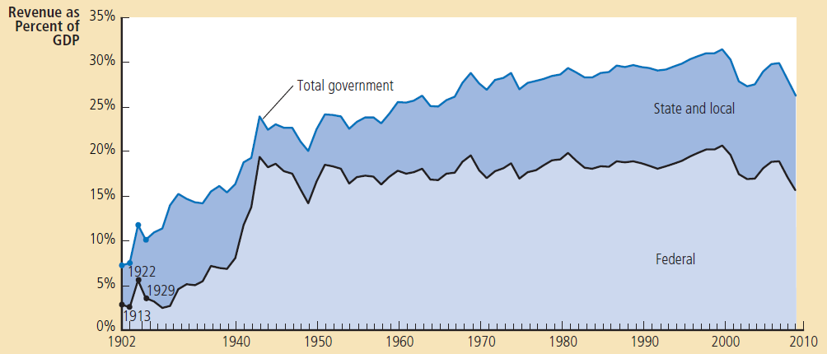
Figure 1
Government Revenue as a Percentage of GDP
This figure shows revenue of the federal government and of state and local governments as a percentage of gross domestic product (GDP), which measures total income in the economy. It shows that the government plays a large role in the U.S. economy and that its role has grown over time.
© 2012 Cengage Learning. All Rights Reserved. May not be copied, scanned, or duplicated, in whole or in part, except for use as permitted in a license distributed with a certain product or service or otherwise on a password-protected website for classroom use.

Slide 4
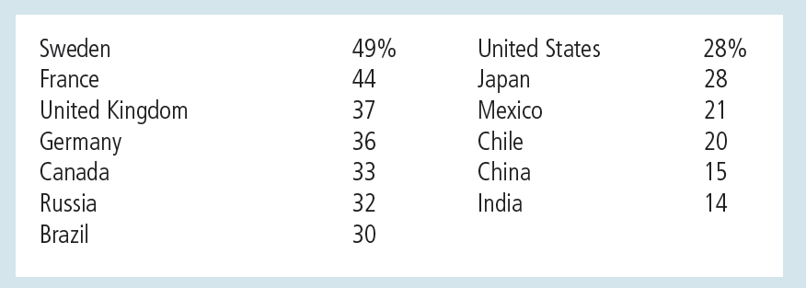
Table 1
Total Government Tax Revenue as a Percentage of GDP
© 2012 Cengage Learning. All Rights Reserved. May not be copied, scanned, or duplicated, in whole or in part, except for use as permitted in a license distributed with a certain product or service or otherwise on a password-protected website for classroom use.

Slide 5
The Federal Government
The federal government’s receipts
  Individual income tax
    Based on total income (marginal tax rate)
  Payroll taxes - tax on wages
    “Social insurance taxes” – pay for Social Security and Medicare
  Corporate income tax - based on profit
  Other:
    Excise tax, estate tax, custom duties
© 2012 Cengage Learning. All Rights Reserved. May not be copied, scanned, or duplicated, in whole or in part, except for use as permitted in a license distributed with a certain product or service or otherwise on a password-protected website for classroom use.

Slide 6
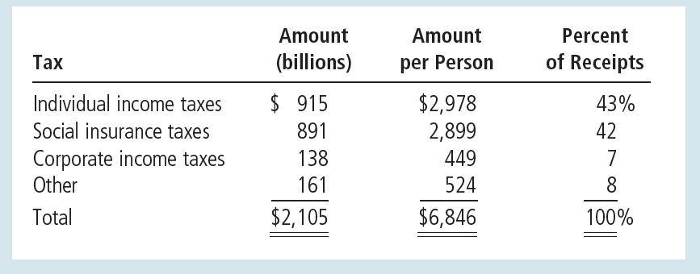
Table 2
Receipts of the Federal Government: 2009
© 2012 Cengage Learning. All Rights Reserved. May not be copied, scanned, or duplicated, in whole or in part, except for use as permitted in a license distributed with a certain product or service or otherwise on a password-protected website for classroom use.

Slide 7
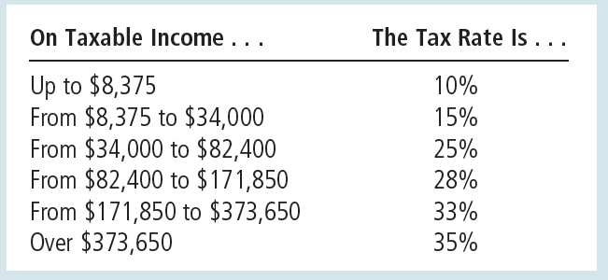
Table 3
The Federal Income Tax Rates: 2010
This table shows the marginal tax rates for an unmarried taxpayer. The taxes owed by a taxpayer depend on all the marginal tax rates up to his or her income level. For example, a taxpayer with income of $25,000 pays 10 percent of the first $8,375 of income, and then 15 percent of the rest.
© 2012 Cengage Learning. All Rights Reserved. May not be copied, scanned, or duplicated, in whole or in part, except for use as permitted in a license distributed with a certain product or service or otherwise on a password-protected website for classroom use.

Slide 8
The Federal Government
The federal government’s spending
  Social Security, 19%
    Transfer payments to the elderly
  National defense, 19%
  Income security, 15%
    Transfer payments to poor families
    Temporary Assistance for Needy Families (TANF)
    Food Stamps
    Unemployed compensation
© 2012 Cengage Learning. All Rights Reserved. May not be copied, scanned, or duplicated, in whole or in part, except for use as permitted in a license distributed with a certain product or service or otherwise on a password-protected website for classroom use.

Slide 9
The Federal Government
The federal government’s spending
  Medicare
    Health plan for the elderly
  Other health spending
    Medicaid - health program for the poor
    Spending on medical research
  Net interest
© 2012 Cengage Learning. All Rights Reserved. May not be copied, scanned, or duplicated, in whole or in part, except for use as permitted in a license distributed with a certain product or service or otherwise on a password-protected website for classroom use.

Slide 10
The Federal Government
The federal government’s spending
  Other spending
    Federal court system
    Space program
    Farm-support programs
    Housing credit program
    Salaries of members of Congress and the president
© 2012 Cengage Learning. All Rights Reserved. May not be copied, scanned, or duplicated, in whole or in part, except for use as permitted in a license distributed with a certain product or service or otherwise on a password-protected website for classroom use.

Slide 11
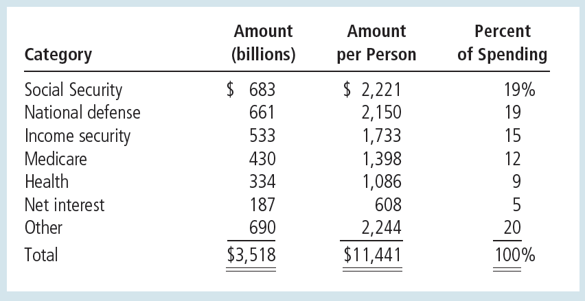
Table 4
Spending of the Federal Government: 2009
© 2012 Cengage Learning. All Rights Reserved. May not be copied, scanned, or duplicated, in whole or in part, except for use as permitted in a license distributed with a certain product or service or otherwise on a password-protected website for classroom use.

Slide 12
The Federal Government
Budget deficit
  Excess of government spending over government receipts
  Financed - borrowing from the public
Budget surplus
  Excess of government receipts over government spending
  Uses the excess receipts to reduce its outstanding debts
© 2012 Cengage Learning. All Rights Reserved. May not be copied, scanned, or duplicated, in whole or in part, except for use as permitted in a license distributed with a certain product or service or otherwise on a password-protected website for classroom use.

Slide 13
The fiscal challenge ahead
2009 - budget deficit = $1,413 billion
  Eightfold increase over the deficit in 2007
  Cause: deep recession of the economy
Long-term projections
  Government - spend vastly more than it will receive in tax revenue
  As a percentage of GDP
    Taxes – constant
    Government spending – rise gradually and substantially
© 2012 Cengage Learning. All Rights Reserved. May not be copied, scanned, or duplicated, in whole or in part, except for use as permitted in a license distributed with a certain product or service or otherwise on a password-protected website for classroom use.

Slide 14
The fiscal challenge ahead
Rise in government spending
  Social Security and Medicare
    Significant benefits for the elderly
      The elderly - growing percentage of overall population
      Medical advances and lifestyle improvements
        Increased life expectancy
    Fewer children, smaller families
      Labor force - growing more slowly
      Fewer workers paying taxes to support the government benefits that each elderly person receives
© 2012 Cengage Learning. All Rights Reserved. May not be copied, scanned, or duplicated, in whole or in part, except for use as permitted in a license distributed with a certain product or service or otherwise on a password-protected website for classroom use.

Slide 15
The fiscal challenge ahead
Rise in government spending
  Rising cost of healthcare
    Medicare – healthcare to the elderly
    Medicaid – healthcare to the poor
    Medical advances
      New, better, and expensive ways to extend and improve our lives
© 2012 Cengage Learning. All Rights Reserved. May not be copied, scanned, or duplicated, in whole or in part, except for use as permitted in a license distributed with a certain product or service or otherwise on a password-protected website for classroom use.

Slide 16
The fiscal challenge ahead
Stem the rise in healthcare costs
  Reduce the burden of lawsuits on the healthcare system
  Encourage more competition among healthcare providers
  Promote greater use of information technology
© 2012 Cengage Learning. All Rights Reserved. May not be copied, scanned, or duplicated, in whole or in part, except for use as permitted in a license distributed with a certain product or service or otherwise on a password-protected website for classroom use.

Slide 17
The fiscal challenge ahead
Handle spending increases
  Increasing budget deficit – not feasible
  Raise taxes - as a percentage of GDP
  Reduce the promises now being made to the elderly of the future
  People - encouraged to take a greater role caring for themselves as they age
    Raising the normal retirement age
    People - more incentive to save during their working years
© 2012 Cengage Learning. All Rights Reserved. May not be copied, scanned, or duplicated, in whole or in part, except for use as permitted in a license distributed with a certain product or service or otherwise on a password-protected website for classroom use.

Slide 18
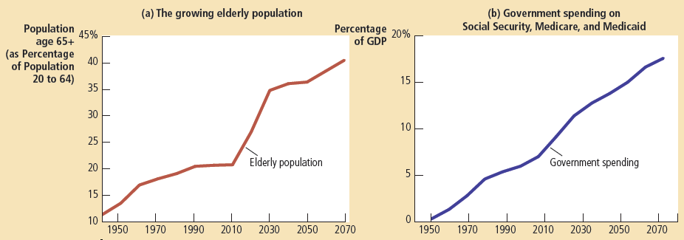
Figure 2
The Demographic and Fiscal Challenge
Panel (a) shows the U.S. population age 65 and older as a percentage of the population age 20 to 64. The growing elderly population will put increasing pressure on the government budget. Panel (b) shows government spending on Social Security, Medicare, and Medicaid as a percentage of GDP. The projection for future years assumes no change in current law. Unless changes in benefits are enacted, government spending on these programs will rise significantly and will require large tax increases to pay for them.
© 2012 Cengage Learning. All Rights Reserved. May not be copied, scanned, or duplicated, in whole or in part, except for use as permitted in a license distributed with a certain product or service or otherwise on a password-protected website for classroom use.

Slide 19
State and Local Government
Receipts
  Sales tax
    Percentage of total amount spent at retail stores
  Property taxes
    Percentage of estimated value of land and structures - paid by property owners
  Individual and corporate income taxes
© 2012 Cengage Learning. All Rights Reserved. May not be copied, scanned, or duplicated, in whole or in part, except for use as permitted in a license distributed with a certain product or service or otherwise on a password-protected website for classroom use.

Slide 20
State and Local Government
Receipts
  Funds from the federal government
  Other receipts
    Fees for fishing and hunting licenses;
    Tolls from roads and bridges
    Fares for public buses and subways
© 2012 Cengage Learning. All Rights Reserved. May not be copied, scanned, or duplicated, in whole or in part, except for use as permitted in a license distributed with a certain product or service or otherwise on a password-protected website for classroom use.

Slide 21
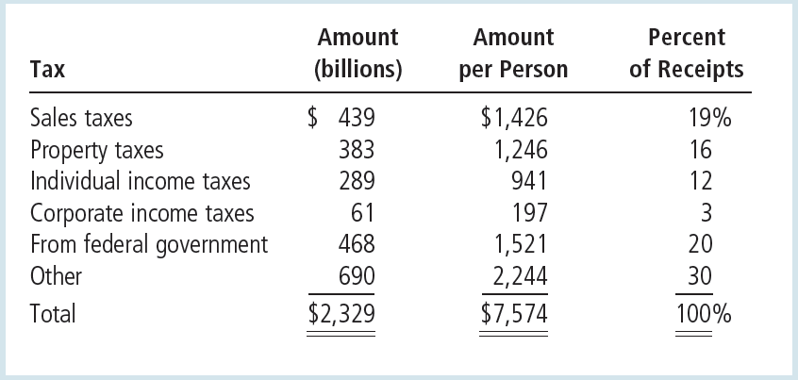
Table 5
Receipts of State and Local Governments: 2007
© 2012 Cengage Learning. All Rights Reserved. May not be copied, scanned, or duplicated, in whole or in part, except for use as permitted in a license distributed with a certain product or service or otherwise on a password-protected website for classroom use.

Slide 22
State and Local Government
Spending
  Education
    Public schools: kindergarten to high school
    Public universities
  Public welfare
    Transfer payments to the poor
  Highways
    Building and maintenance of roads
© 2012 Cengage Learning. All Rights Reserved. May not be copied, scanned, or duplicated, in whole or in part, except for use as permitted in a license distributed with a certain product or service or otherwise on a password-protected website for classroom use.

Slide 23
State and Local Government
Spending
  Other spending
    Libraries
    Police
    Garbage removal
    Fire protection
    Park maintenance
    Snow removal
© 2012 Cengage Learning. All Rights Reserved. May not be copied, scanned, or duplicated, in whole or in part, except for use as permitted in a license distributed with a certain product or service or otherwise on a password-protected website for classroom use.

Slide 24
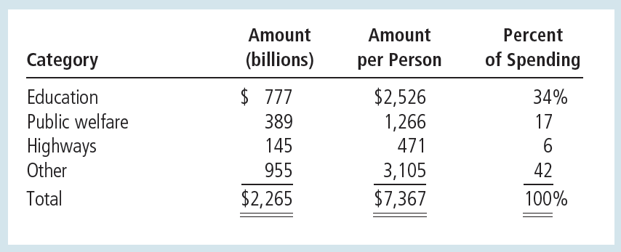
Table 6
Spending of State and Local Governments: 2007
© 2012 Cengage Learning. All Rights Reserved. May not be copied, scanned, or duplicated, in whole or in part, except for use as permitted in a license distributed with a certain product or service or otherwise on a password-protected website for classroom use.

Slide 25
Taxes and Efficiency
Policymakers - adopt a tax system
  Equity and efficiency
Costs of taxes to taxpayers
  Tax payment itself
  Deadweight losses
    Result when taxes distort the decisions that people make
  Administrative burdens
    Taxpayers bear as they comply with the tax laws
© 2012 Cengage Learning. All Rights Reserved. May not be copied, scanned, or duplicated, in whole or in part, except for use as permitted in a license distributed with a certain product or service or otherwise on a password-protected website for classroom use.

Slide 26
Taxes and Efficiency
Efficient tax system
  Small deadweight losses
  Small administrative burdens
Deadweight losses
  People respond to incentives
  Government – tax a good
    People buy less of it
  Taxes – distort incentives
© 2012 Cengage Learning. All Rights Reserved. May not be copied, scanned, or duplicated, in whole or in part, except for use as permitted in a license distributed with a certain product or service or otherwise on a password-protected website for classroom use.

Slide 27
Taxes and Efficiency
Deadweight losses
  Reduction in economic well-being of taxpayers
    In excess of the amount of revenue raised by the government
  Inefficiency
    People allocate resources according to the tax incentive
      Not according to true costs and benefits
© 2012 Cengage Learning. All Rights Reserved. May not be copied, scanned, or duplicated, in whole or in part, except for use as permitted in a license distributed with a certain product or service or otherwise on a password-protected website for classroom use.

Slide 28
Taxes and Efficiency
Tax a good
  Consumer surplus – drops
  Tax revenue – increases
  Decrease in consumer surplus > increase in tax revenue
  Deadweight loss
© 2012 Cengage Learning. All Rights Reserved. May not be copied, scanned, or duplicated, in whole or in part, except for use as permitted in a license distributed with a certain product or service or otherwise on a password-protected website for classroom use.

Slide 29
Should income or consumption be taxed?
Taxes - induce people to change their behavior
  Deadweight losses
  Less efficient allocation of resources
Current tax system: Individual income tax
  Tax the amount of income people earn
  Discourages people from working as hard
  Discourages people from saving
© 2012 Cengage Learning. All Rights Reserved. May not be copied, scanned, or duplicated, in whole or in part, except for use as permitted in a license distributed with a certain product or service or otherwise on a password-protected website for classroom use.

Slide 30
Should income or consumption be taxed?
Changing the basis of taxation
  Eliminate disincentive toward saving
  Consumption tax
    Tax the amount that people spend
    Income saved - not be taxed until the saving is later spent
    Not distort people’s saving decisions
© 2012 Cengage Learning. All Rights Reserved. May not be copied, scanned, or duplicated, in whole or in part, except for use as permitted in a license distributed with a certain product or service or otherwise on a password-protected website for classroom use.

Slide 31
Should income or consumption be taxed?
European countries
  Rely more on consumption taxes than does the US
  Value-added tax (VAT)
    Tax is collected in stages as the good is being produced
© 2012 Cengage Learning. All Rights Reserved. May not be copied, scanned, or duplicated, in whole or in part, except for use as permitted in a license distributed with a certain product or service or otherwise on a password-protected website for classroom use.

Slide 32
Taxes and Efficiency
Administrative burden
  Time spent to fill out forms
  Time spent throughout the year keeping records for tax purposes
  Resources the government has to use to enforce the tax laws
  Tax lawyers and accountants
    Legal tax avoidance
© 2012 Cengage Learning. All Rights Reserved. May not be copied, scanned, or duplicated, in whole or in part, except for use as permitted in a license distributed with a certain product or service or otherwise on a password-protected website for classroom use.

Slide 33
Taxes and Efficiency
Administrative burden
  Resources devoted to complying with tax laws
    Deadweight loss
  Can be reduced – simplify the tax laws
    Politically difficult
© 2012 Cengage Learning. All Rights Reserved. May not be copied, scanned, or duplicated, in whole or in part, except for use as permitted in a license distributed with a certain product or service or otherwise on a password-protected website for classroom use.

Slide 34
Taxes and Efficiency
Average tax rate
  Total taxes paid divided by total income
  Sacrifice made by a taxpayer
    Fraction of income paid in taxes
Marginal tax rate
  The extra taxes paid on an additional dollar of income
  How much tax system distort incentives
  Determines the deadweight loss
© 2012 Cengage Learning. All Rights Reserved. May not be copied, scanned, or duplicated, in whole or in part, except for use as permitted in a license distributed with a certain product or service or otherwise on a password-protected website for classroom use.

Slide 35
Taxes and Efficiency
Lump-sum taxes
  Same amount of tax for every person
  Most efficient tax possible
    A person’s decisions do not alter the amount owed
  Doesn’t distort incentives
  Doesn’t cause deadweight losses
  Imposes a minimal administrative burden
  No equity
© 2012 Cengage Learning. All Rights Reserved. May not be copied, scanned, or duplicated, in whole or in part, except for use as permitted in a license distributed with a certain product or service or otherwise on a password-protected website for classroom use.

Slide 36
Taxes and Equity
The benefits principle
  People should pay taxes based on the benefits they receive from government services
  Tries to make public goods similar to private goods
  A person who gets great benefit from a public good should pay more for it than a person who gets little benefit
© 2012 Cengage Learning. All Rights Reserved. May not be copied, scanned, or duplicated, in whole or in part, except for use as permitted in a license distributed with a certain product or service or otherwise on a password-protected website for classroom use.

Slide 37
Taxes and Equity
The ability-to-pay principle
  Taxes should be levied on a person according to how well that person can shoulder the burden
Vertical equity
  Taxpayers with a greater ability to pay taxes should pay larger amounts
  Richer taxpayers should pay more than poorer taxpayers
© 2012 Cengage Learning. All Rights Reserved. May not be copied, scanned, or duplicated, in whole or in part, except for use as permitted in a license distributed with a certain product or service or otherwise on a password-protected website for classroom use.

Slide 38
Taxes and Equity
Vertical equity
  How much more should the rich pay?
    Proportional tax
      High-income and low-income taxpayers pay the same fraction of income
    Regressive tax
      High-income taxpayers pay a smaller fraction of their income than do low-income taxpayers
    Progressive tax
      High-income taxpayers pay a larger fraction of their income than do low-income taxpayers
© 2012 Cengage Learning. All Rights Reserved. May not be copied, scanned, or duplicated, in whole or in part, except for use as permitted in a license distributed with a certain product or service or otherwise on a password-protected website for classroom use.

Slide 39
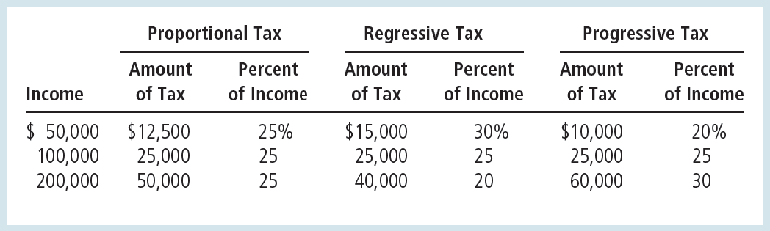
Table 7
Three Tax Systems
© 2012 Cengage Learning. All Rights Reserved. May not be copied, scanned, or duplicated, in whole or in part, except for use as permitted in a license distributed with a certain product or service or otherwise on a password-protected website for classroom use.

Slide 40
How the tax burden is distributed
Do the wealthy pay their fair share of taxes?
United States federal tax system
  Progressive tax system
Families - ranked according to their income
  Five groups of equal size, “quintiles”
© 2012 Cengage Learning. All Rights Reserved. May not be copied, scanned, or duplicated, in whole or in part, except for use as permitted in a license distributed with a certain product or service or otherwise on a password-protected website for classroom use.

Slide 41
How the tax burden is distributed
The poorest quintile
  Average income = $17,200
    Earns 3.9% of all income
  Taxes = 4.3% of income
    Pays 0.8% of all taxes
The richest quintile
  Average income = $284,400
    Earns 55.7% of all income
  Taxes = 25.8% of income
    Pays 69.3% of all taxes
© 2012 Cengage Learning. All Rights Reserved. May not be copied, scanned, or duplicated, in whole or in part, except for use as permitted in a license distributed with a certain product or service or otherwise on a password-protected website for classroom use.

Slide 42
How the tax burden is distributed
The richest 1%
  Average income = over $1.7 million
    Earns 18.8% of all income
  Taxes = 31.2% of income
    Pays 28.3% of all taxes
© 2012 Cengage Learning. All Rights Reserved. May not be copied, scanned, or duplicated, in whole or in part, except for use as permitted in a license distributed with a certain product or service or otherwise on a password-protected website for classroom use.

Slide 43
How the tax burden is distributed
Account for taxes and transfer payments
  Even greater progressivity
  Richest families
    Pays about 25% of income to the government, after transfers
  Poor families
    Receive more in transfers than they pay in taxes
      Average tax rate = negative 30%
© 2012 Cengage Learning. All Rights Reserved. May not be copied, scanned, or duplicated, in whole or in part, except for use as permitted in a license distributed with a certain product or service or otherwise on a password-protected website for classroom use.

Slide 44
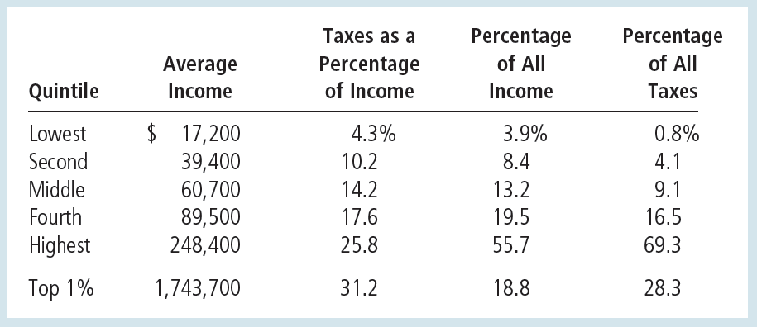
Table 8
The Burden of Federal Taxes
© 2012 Cengage Learning. All Rights Reserved. May not be copied, scanned, or duplicated, in whole or in part, except for use as permitted in a license distributed with a certain product or service or otherwise on a password-protected website for classroom use.

Slide 45
Taxes and Equity
Horizontal equity
  Taxpayers with similar abilities to pay taxes should pay the same amount
  Similar taxpayers
    Determine which differences are relevant for a family’s ability to pay and which differences are not
  U.S. income tax
    Special provisions that alter a family’s tax based on its specific circumstances
© 2012 Cengage Learning. All Rights Reserved. May not be copied, scanned, or duplicated, in whole or in part, except for use as permitted in a license distributed with a certain product or service or otherwise on a password-protected website for classroom use.

Slide 46
Taxes and Equity
Tax incidence
  Who bears the burden of taxes
  Central to evaluating tax equity
  Person who bears the burden a tax
    Not always the person who gets the tax bill from the government
Taxes alter supply and demand
  Alter equilibrium prices
  Indirect effects
© 2012 Cengage Learning. All Rights Reserved. May not be copied, scanned, or duplicated, in whole or in part, except for use as permitted in a license distributed with a certain product or service or otherwise on a password-protected website for classroom use.

Slide 47
Who pays the corporate income tax?
People pay all taxes
Tax on a corporation
  Corporation – more like a tax collector than taxpayer
  Burden of the tax ultimately falls on people
  Workers and customers bear much of the burden of the corporate income tax
  Popular - it appears to be paid by rich corporations
© 2012 Cengage Learning. All Rights Reserved. May not be copied, scanned, or duplicated, in whole or in part, except for use as permitted in a license distributed with a certain product or service or otherwise on a password-protected website for classroom use.

